Slide 1



Crack Detection on Structures using AI and ML
Name : Atharva Khadse
Notes:
1

Slide 2

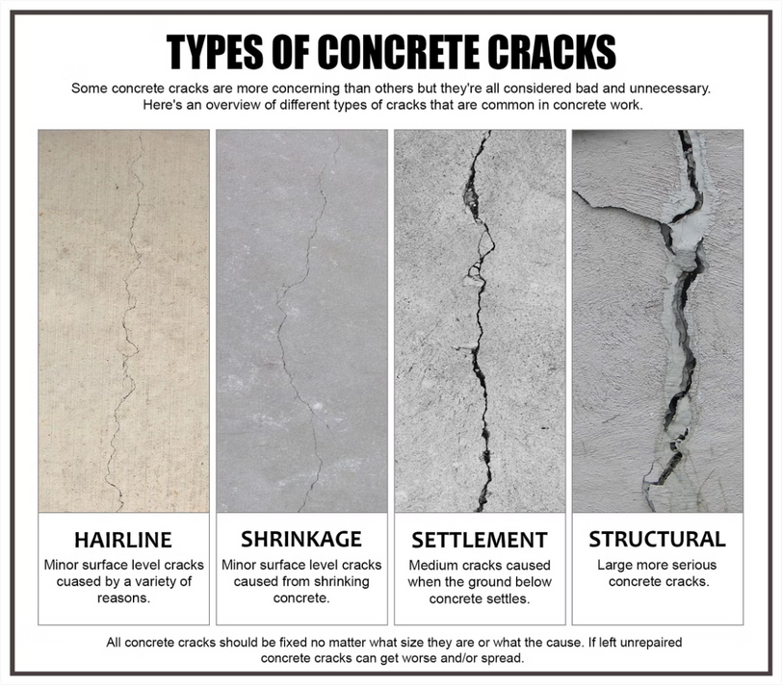
Abstract
This project aims to develop an advanced crack detection system by integrating a U-Net deep learning model with real-time camera feeds for continuous infrastructure monitoring. Cracks in structures such as bridges, roads, and buildings pose significant risks, making timely detection crucial for maintenance and safety.
1
Purpose
2
Methodology
Develop a working application for implementing
the trained model for real time detection .
The project trains a U-Net model on a curated dataset of images and crack masks, with preprocessing for uniformity and data split into training and validation sets.
3
Impact
Manual inspection methods for crack detection are time-consuming and error-prone, highlighting the need for automation. The proposed system uses a U-Net model, known for its strength in semantic segmentation, to accurately detect and segment cracks .
Notes:
2

Slide 3

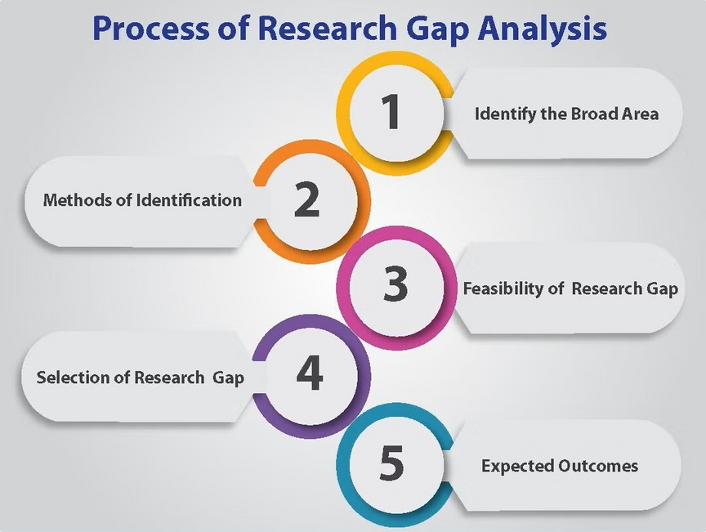
Research Gap
While existing research offers promising approaches, a significant research gap remains in developing robust and scalable AI-powered crack detection systems for real-world applications.
Diverse Datasets
1
Cracks come in various shapes and sizes. A comprehensive dataset integrating all the variations was not seen.
2
Complex Crack Patterns
Cracks in real-world structures exhibit varying sizes, shapes, and appearances, making detection challenging.
Environmental Factors
3
Factors like lighting, shadows, and surface textures can significantly affect crack detection accuracy.
4
Noise Reduction and Fine-Tuning for Improved Accuracy
Crack detection models can be sensitive to noise in the input images, such as distortions which can negatively impact accuracy and reliability
Real-Time Processing
5
An application based approach for real-time video detection was not found.
Notes:
3

Slide 4


Objectives
This research aims to address the identified research gaps by developing an innovative AI-powered crack detection system.
1
Model Training and Fine-tuning on Crack Detection Dataset
Develop a robust and accurate AI model capable of detecting and classifying cracks in structural elements.
2
Contour Detection for Crack Localization
Apply contour detection on the predicted crack masks to outline and visualize the cracks effectively.
3
Real-Time Crack Detection from Camera Feeds
Implement real-time crack detection using live camera feeds, ensuring smooth and accurate detection with low latency.
Notes:
4

Slide 5







Project Plan
The project will be structured in a sequential manner, encompassing distinct phases.
Phase 1: Data Collection and Model Training
Training of the model using the image dataset along with their masks. The images and masks are preprocessed to ensure consistency in dimensions and normalization.
Phase 2: Refining the model by removing noise
Once the model is trained, refinement involves several post-processing steps to reduce noise and enhance the accuracy of the crack detection.
Phase 3: Detection of cracks using the trained model
Crack detection is carried out on new, unseen images. The trained U-Net model processes these images to generate segmentation masks that highlight areas with cracks.
Phase 4: Integrating the model to be used in real time camera feed
Integrating the U-Net model into a real-time camera feed.Each frame from the camera feed is processed through the U-Net model, which segments the image to identify cracks.
Notes:
5

Slide 6
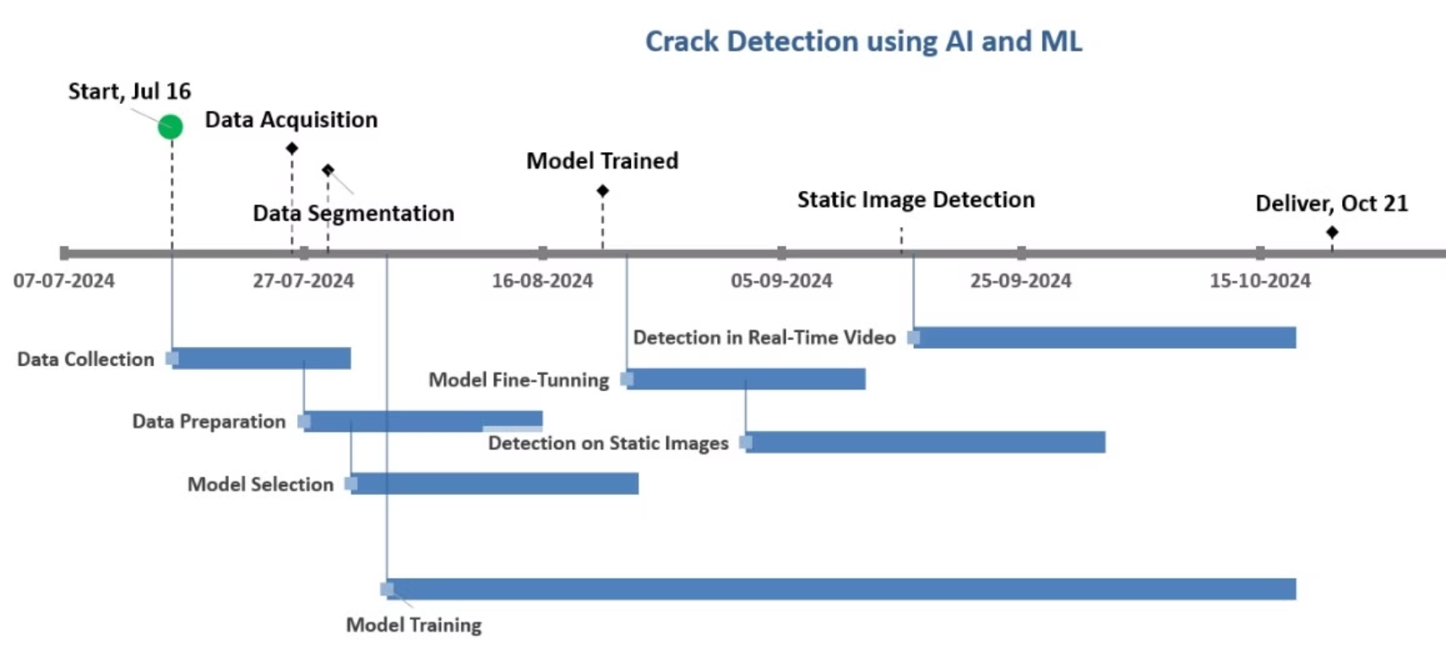
Activity Chart with Milestones
Notes:
6

Slide 7


Analysis and Requirements
Cracks in infrastructure, such as buildings, roads, bridges, can lead to structural failures if left undetected. Manual inspection is time-consuming, prone to human error, and often unsafe. An automated crack detection system using a deep learning model (U-Net) will help identify cracks in both static images and real-time video feeds, providing a faster, more accurate, and scalable solution for structural monitoring and maintenance.
1. Data Collection and Management
Requirement: The system needs access to a diverse dataset of crack images and corresponding labeled masks for training and testing the model.
Considerations: Dataset must cover various crack types, environments lighting conditions, and surface textures.
2. Model Training and Development
Requirement: The system must train a U-Net model to detect cracks by learning the patterns from labeled images.
Considerations: Proper selection of model hyperparameters (batch size, epochs).Sufficient computational resources (GPU for training).Data Rescaling techniques to improve model generalization (e.g., rotation, zoom, brightness adjustments).
Notes:
7

Slide 8


3. Crack Detection on Static Images
Requirement: User has to upload images for crack detection and receive results with contours and bounding boxes drawn around detected cracks.
Considerations: Fast inference time for static image analysis. Accurate contour generation to match the crack's shape. User-friendly interface to view and analyze results.
4. Contour and Bounding Box Generation
Requirement: Draw contours around detected cracks and provide bounding boxes to quantify their location and size.
Considerations: Precision in contour generation to avoid false positives. Dynamic bounding box adjustments based on crack size and shape.
5. Real-Time Crack Detection via Camera Feed
Requirement: The system must integrate with a live camera feed for continuous crack detection and processing in real-time.
Considerations:High frame rate processing (e.g., 30 FPS) to avoid delays.Low latency between frame capture and detection output.Handling environmental changes like lighting and motion blur in real-time video feeds.
Notes:
8

Slide 9

6. User Interface and Interaction
Requirement: The application must have an intuitive and interactive user interface that allows users to upload images, start live detection and view detected result.
Considerations: Simple and responsive UI for end users (engineers, inspectors).Options for exporting detected crack data for reporting purposes.
7. System Performance and Scalability
Requirement: The application must be optimized for speed and accuracy, capable of running on both high-end systems (e.g., servers) and resource-constrained devices (e.g., edge devices).
Considerations:Use of optimized model deployment tools like TensorRT, ONNX, or TensorFlow Lite for edge device compatibility.Scalability to handle multiple image inputs or video streams simultaneously.
8. Deployment and Maintenance
Requirement: The system must be deployable in real-world environments, with continuous monitoring and updating of the model for improved accuracy.
Considerations:Easy model updating (e.g., incremental training with new data).Regular maintenance to ensure system uptime and accuracy.
Notes:
9

Slide 10




System Design
The proposed system will be designed as a modular architecture, comprising distinct components.
Image Acquisition
Image Preprocessing
Crack Detection Model
Result Visualization and Reporting
Capture images of structural elements using high-resolution cameras or drones.
Enhance image quality, remove noise, and perform geometric corrections.
Implement a deep learning model, such as a Convolutional Neural Network (CNN), for crack detection and classification.
Display detected cracks on the original images and provide detailed reports with relevant information.
Design Overview
The crack detection system is designed to identify cracks in both static images and real-time video feeds using deep learning, specifically the U-Net model. The system needs to ensure robust performance under various environmental and operational constraints.
Key Components:
Image Input Pipeline: For both static images and live camera feeds.
Preprocessing Module: Image resizing, normalization, and augmentation.
U-Net Model: For segmentation of cracks.
Post-Processing: Contour generation and bounding box creation.
User Interface: For visualizing results and crack measurements.
Deployment: System optimized for edge or cloud deployment.
Notes:
10

Slide 11
Model Performance Benchmarking
Accuracy Metrics:
Intersection over Union (IoU): Compare the predicted crack segmentation masks with the ground truth to measure how accurately the model detects cracks. An IoU score of 0.7 or higher is considered good for this application.
Precision and Recall:
Precision: The proportion of correctly detected cracks out of all detected cracks. A precision score of 90% or higher is ideal to avoid false positives.
Recall: The proportion of actual cracks that are correctly detected. A recall score of 85% or higher ensures the model doesn’t miss significant cracks.
F1 Score: The harmonic mean of precision and recall, providing a balance between both. Aim for an F1 score of 85% or higher.
Benchmarking Process:
Train the U-Net model on a dataset and validate on unseen test data.
Compare model performance across multiple datasets (with varying crack types and environments).
Measure accuracy against other crack detection methods (e.g., classical image processing, other deep learning models).
Notes:
11

Slide 12
Inference Speed Benchmarking
Static Image Inference:
Processing Time per Image: The time it takes for the model to process a single static image (256x256 resolution). A benchmark of less than 100 ms per image is ideal for near real-time processing in an offline mode.
Real-Time Video Inference:
Frames per Second (FPS): The system should process real-time video at a minimum of 30 FPS to ensure smooth and continuous crack detection without noticeable lag.
Latency: End-to-end delay from when a frame is captured by the camera to when the detection results are displayed. The goal is to keep latency below 200 ms to make the system feel responsive in real-time scenarios.
Benchmarking Process:
Test the model on different hardware platforms (high-end GPUs, edge devices like NVIDIA Jetson) to ensure the processing time meets the real-time constraints.
Compare speed optimizations such as model quantization and pruning to reduce latency.
Notes:
12

Slide 13


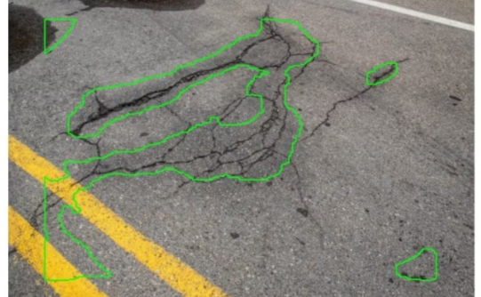
Implementation and Evaluation
The proposed AI-powered crack detection system will be implemented and evaluated using a comprehensive methodology.
Model Training
Performance Evaluation
Real-World Validation
Train the U-Net deep learning model using the annotated crack dataset.
Evaluate the model's accuracy, precision, recall, and F1-score on test datasets.
Test the system's performance in real-world scenarios and assess its effectiveness in detecting and classifying cracks in various structural elements.
Notes:
13

Slide 14
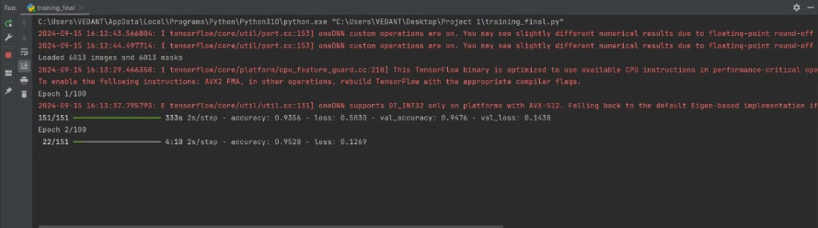
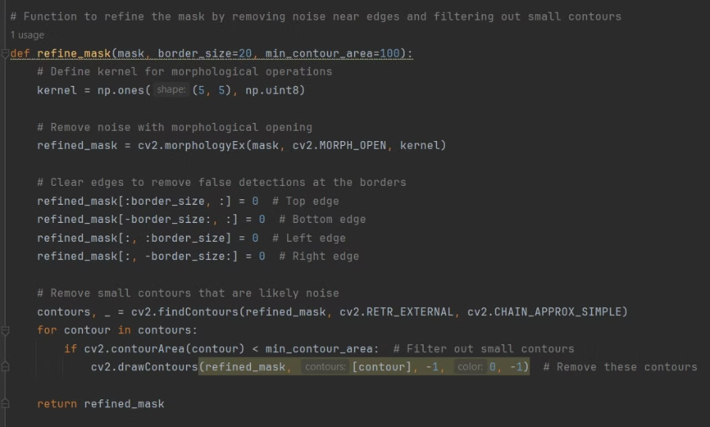
Model Training
Model Fine-Tunning
Notes:
14

Slide 15
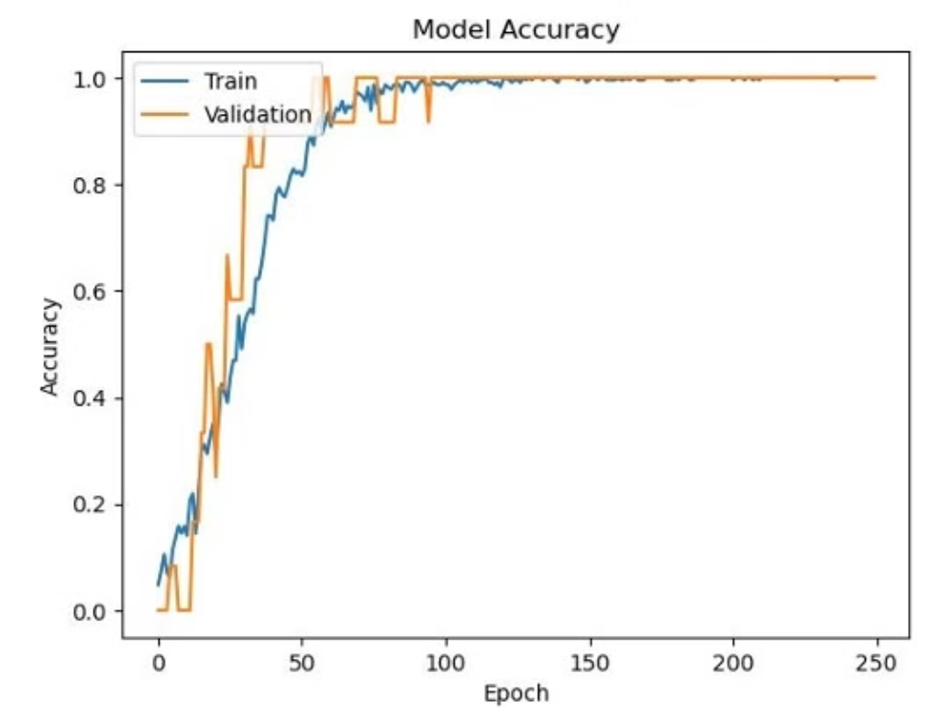
Notes:
15

Slide 16
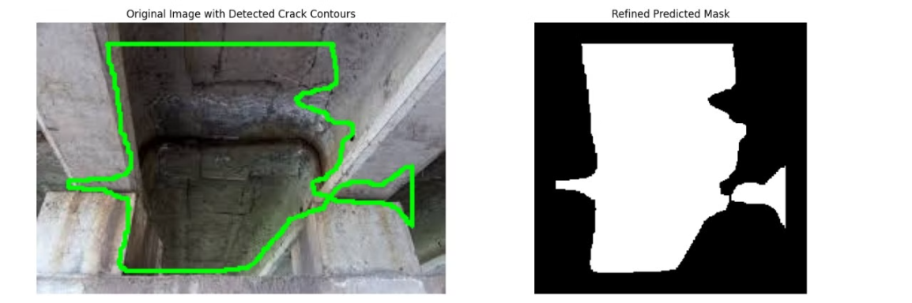
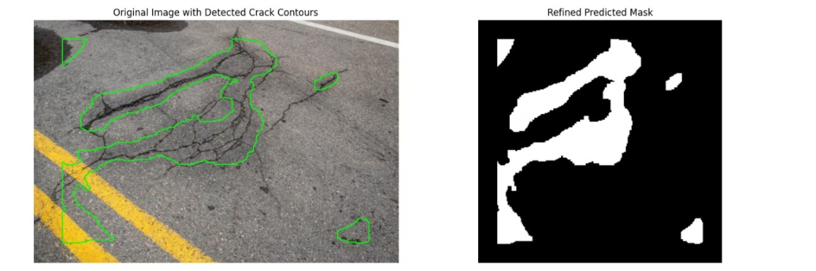
Detection on Static Image
Notes:
16

Slide 17
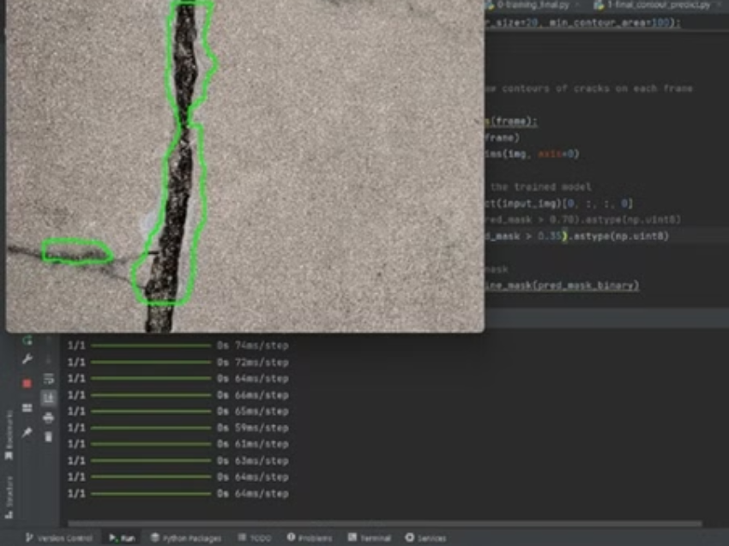
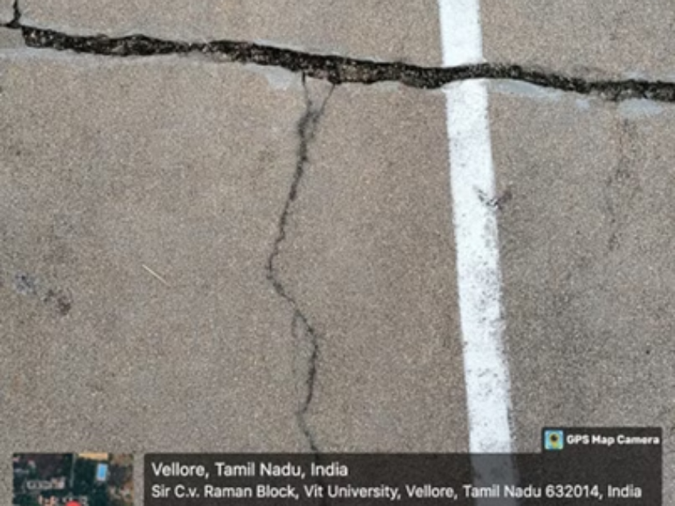
Real-time Detection on camera feed
Notes:
17

Slide 18
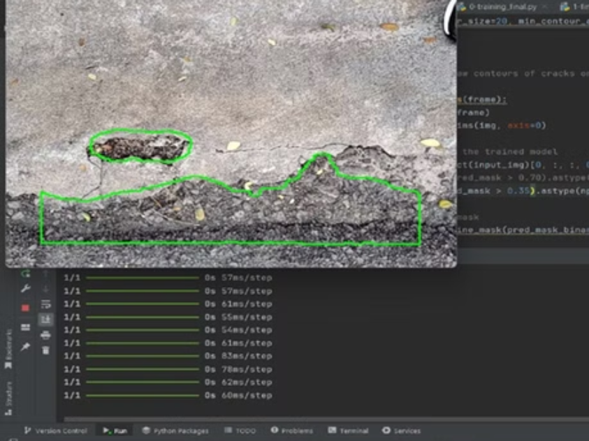
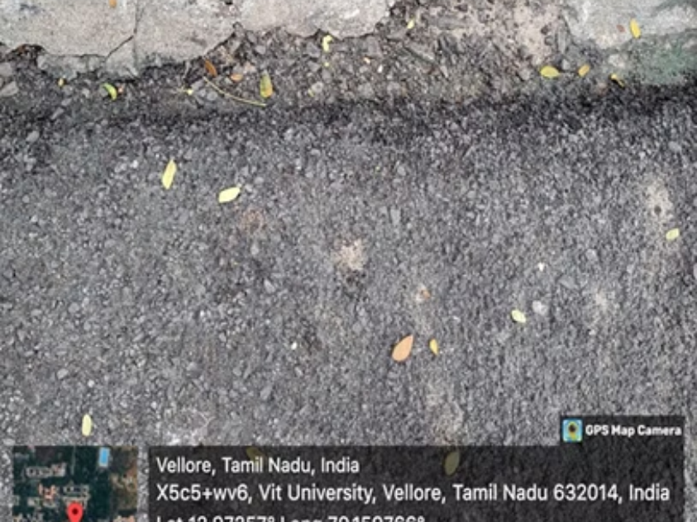
Notes:
18

Slide 19
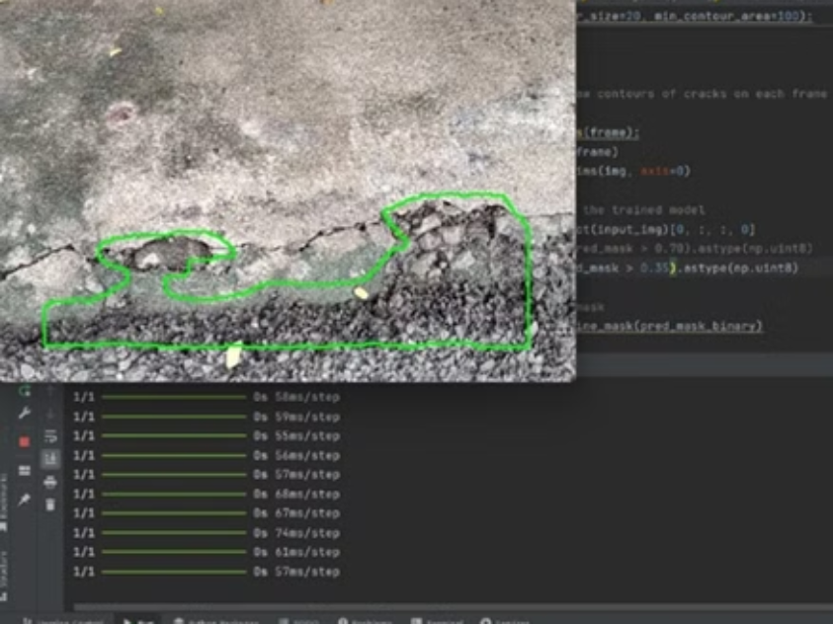
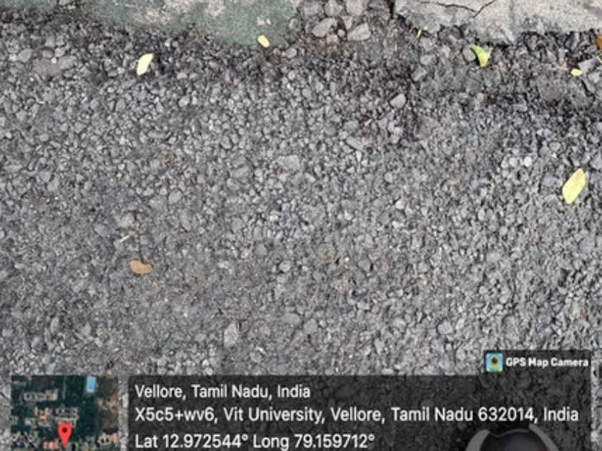
Notes:
19

Slide 20
Conclusion and Future Scope
This project successfully developed and implemented an automated crack detection system based on a U-Net deep learning model, designed to address critical infrastructure monitoring needs. Starting with extensive data collection, the project ensured high-quality inputs by resizing, normalizing, and validating paired image-mask datasets. These steps were fundamental for creating a reliable training dataset, which contributed to the model's capacity to generalize well across various testing conditions. The U-Net architecture, known for its efficiency in segmentation tasks, was central to this solution, with its encoder-decoder structure allowing the model to capture fine-grained spatial details essential for crack localization and segmentation. The project was developed with cost efficiency in mind, incurring minimal expenses beyond cloud computing for model training and testing. This makes the solution scalable and accessible, especially for sectors with budgetary constraints. The system’s modular design further allows easy integration with various data sources, such as drones or on-site cameras, broadening its application scope. Through this project, the U-Net model has proven to be a viable and scalable solution for infrastructure monitoring, facilitating proactive maintenance strategies that can save both time and resources.
As future scope, an integrated mobile/web application which leverages this algorithm with real time detection along with GPS tagging for marking critical cracks to systematically perform maintenance is viable. This reduces dependence on manual marking and minimizes service disruptions.
Notes:
20

Slide 21
References
Journals:
1. Li, Y., & Xu, H. (2021). "Deep Learning Approaches for Crack Detection in Infrastructure Monitoring." Computers & Structures, 242, 106244.
2. Zhang, H., & Wang, X. (2020). "A Review of Machine Learning Algorithms for Image Classification." Journal of Machine Learning Research, 21(1), 1-45.
3. Wang, J., & Zhou, Z. (2021). "Advanced Techniques for Crack Detection Using Convolutional Neural Networks." Journal of Civil Structural Health Monitoring, 11(2), 219-231.
4. Khan, A., & Hasan, M. (2019). "Crack Detection in Concrete Structures Using Deep Learning." Construction and Building Materials, 210, 195-204.
5. Rao, S., & Gupta, R. (2022). "Automatic Crack Detection in Pavements Using Machine Learning Techniques." Journal of Transportation Engineering, 148(5), 04022032.
Notes:
21

